Slide 1
Car Accident Severity Project
By SRINATH P

Slide 2
Data source
The data was collected by the Seattle Police Department and Accident Traffic Records Department from 2004 to present.
The data consists of 37 independent variables and 194,673 rows.

Slide 3
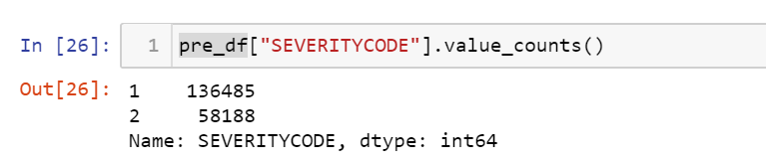
Data pre-processing
In order to prepare the data, first, we need to drop the non-relevant columns. In addition, most of the features are of object data types that need to be converted into numerical data types.

Slide 4
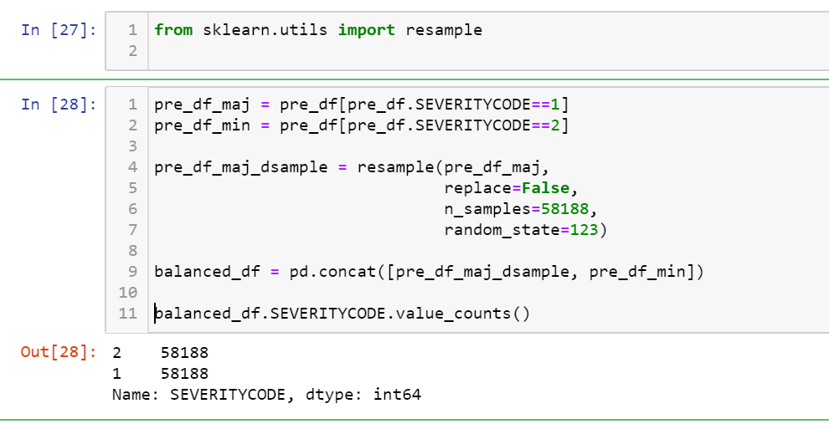

Slide 5
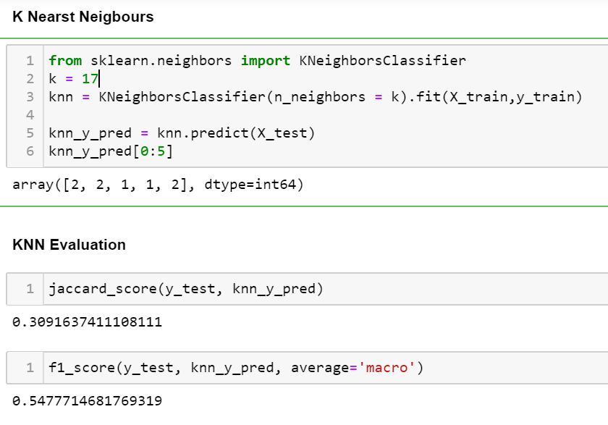
KNN

Slide 6
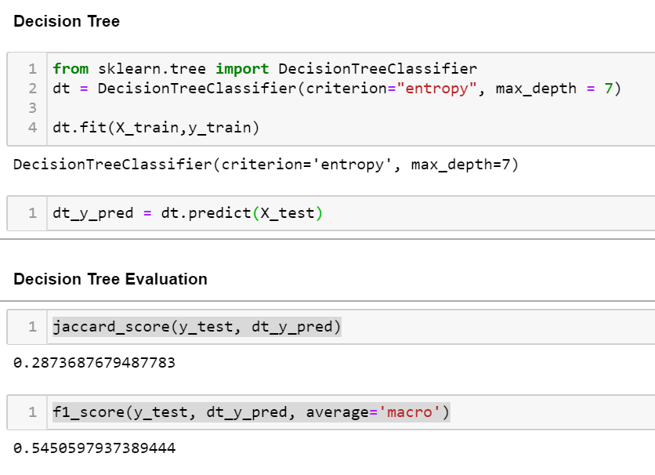
Decision tree

Slide 7
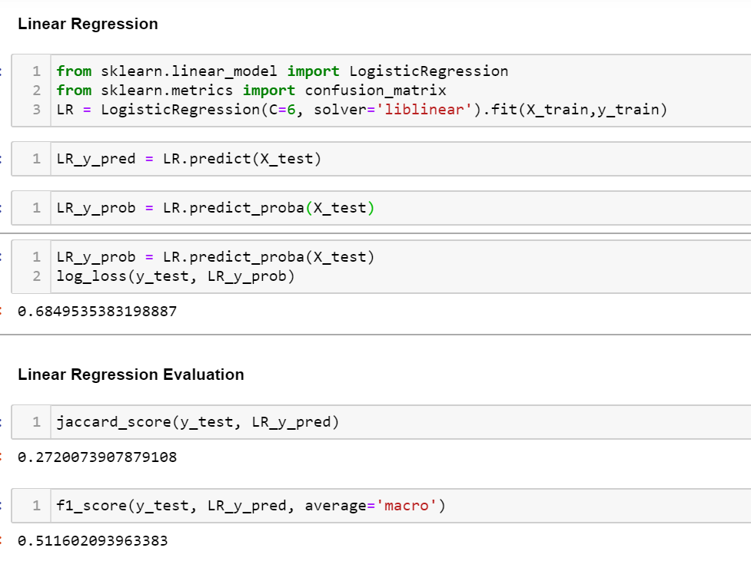
Liner Regression

Slide 8
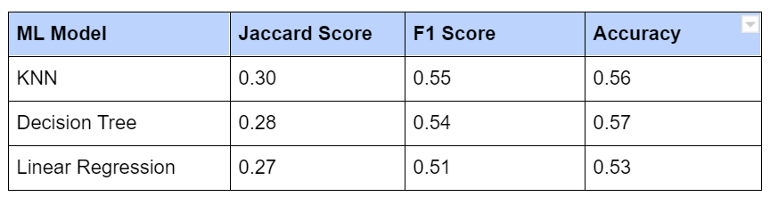
Results

Slide 9
Evaluation
KNN is the best model to predict car accident severity.
particular conditions have a somewhat impact on whether or not travel could result in property damage (class 1) or injury (class 2).

